Slide 1
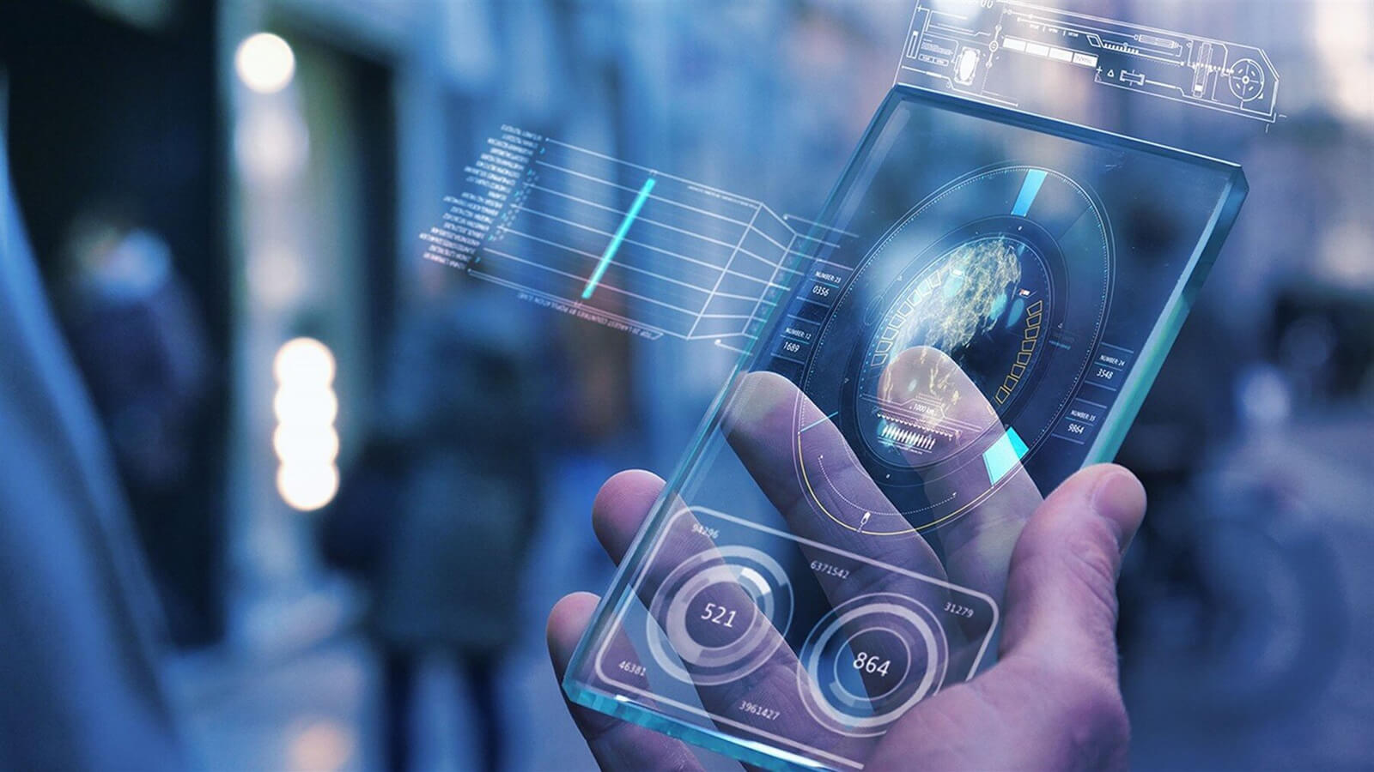

Embellishment of human using AR technology
Seshadri Rao Gudlavalleru Engineering College
Envisioning the future of tomorrow
K. Rohit – 21481A5451
K. Jaswanth – 21481A5457

Slide 2


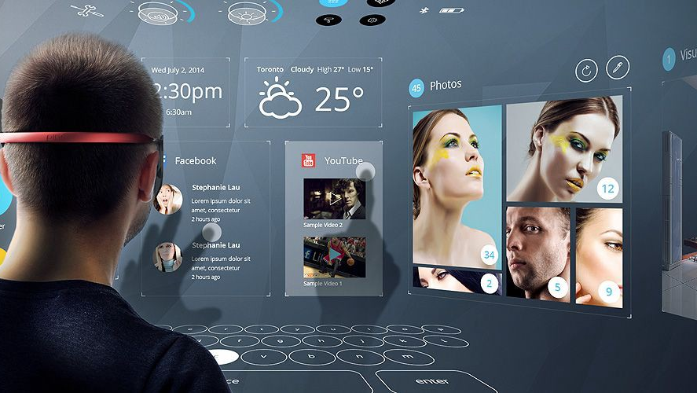
Main objective Of Our Idea
To Enhance the consumer shopping Experience.
Try different clothing styles, beard styles, glasses, shoes, belts, headwear, eye color, skin color, hair color, necklaces, rings, eyebrows, lipstick, nail paint, and so on...
Also used in healthcare, surveillance, training, entertainment and other fields...

Slide 3
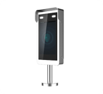

Augmented Reality
A combination of a user-viewed real scene and a computer-generated virtual scene that enhances the scene with additional information
It enhances a real-world environment with video, music, and other senses in real time.
Being employed in a wide range of industries. Applications like snap chat, Google maps

Slide 4

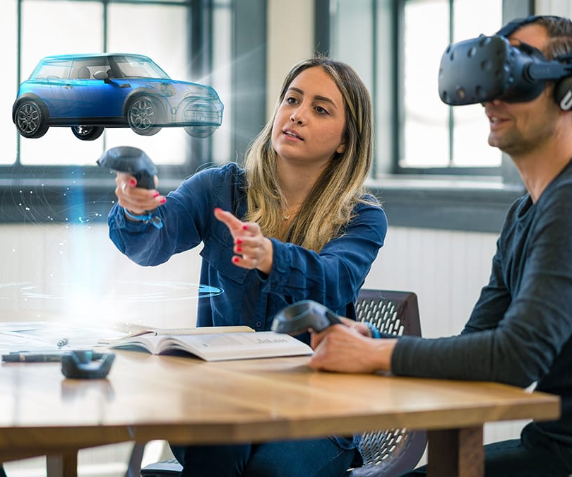
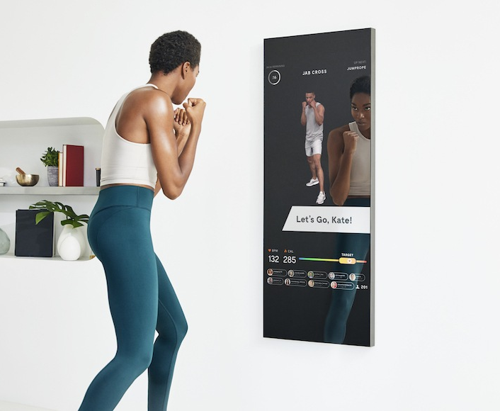

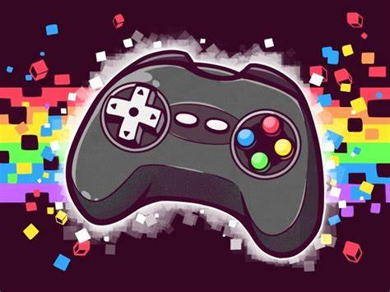
Applications of Augmented Reality
Smart Product
Medical
Fashion
Security
Education
Engineering design
Entertainment
Robotics
Marketing & Shopping
Gaming

Slide 5
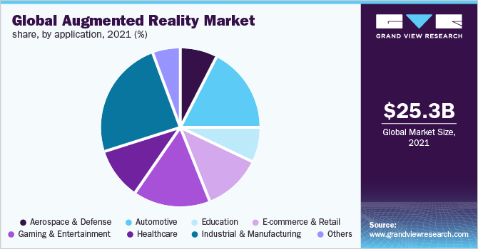
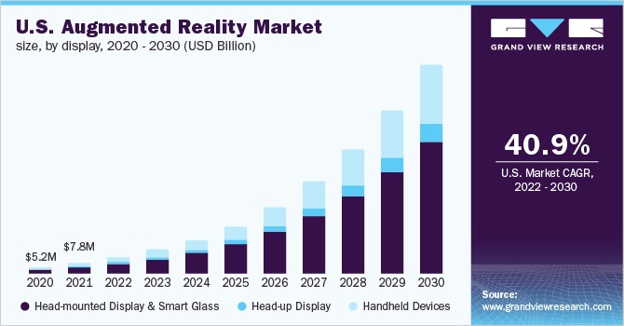
Augmented Reality
Augmented Reality market increasing gradually globally
People are interested in experiencing newer technology like AR
Implementing AR everywhere leads humans enhanced way of living.

Slide 6
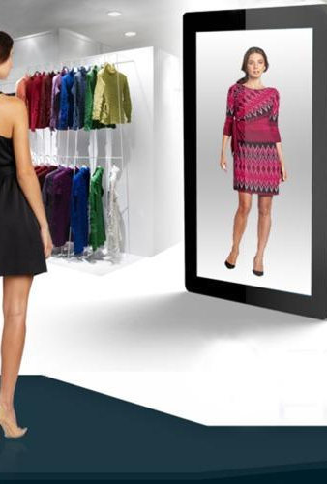
WORKING PROCESS
In-Mirror Camera Detects the real object
Estimates the body data and detects the skin tone.
Creates an abstract model of the body
Shows the desired garments and wearables in mirror

Slide 7
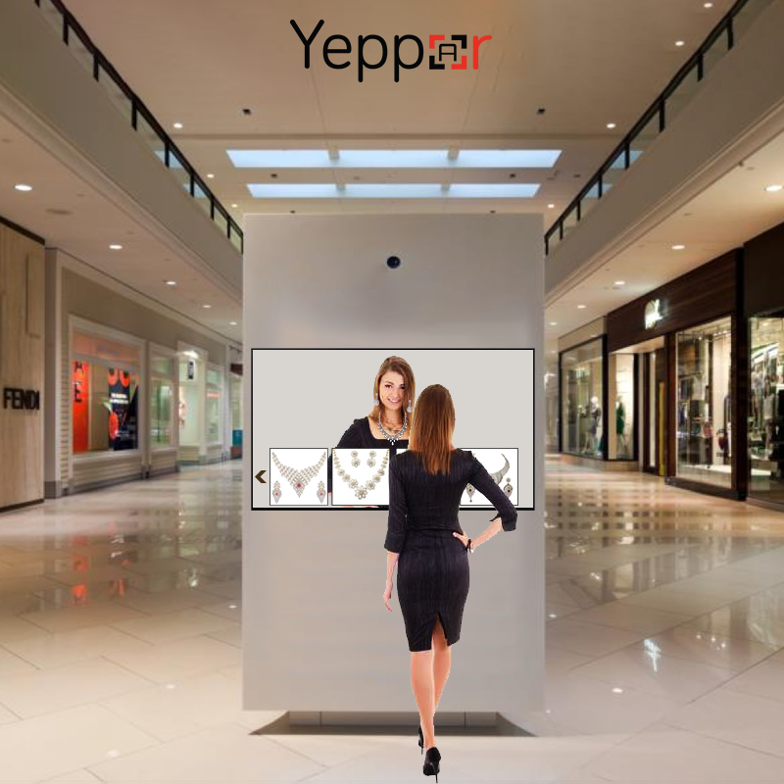
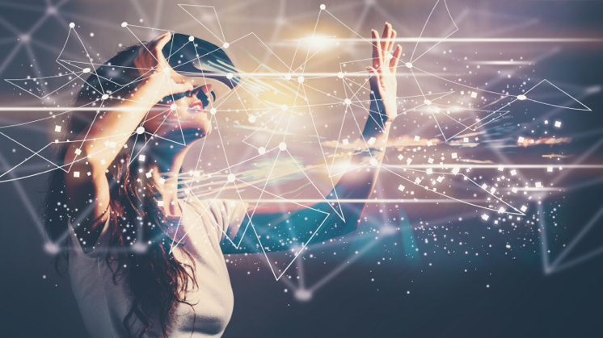
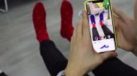
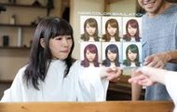
Fashioning the world
the Augmented Reality-based Magic Mirror Fashion Coordination System

Slide 8

Thank You
someone@example.com

